Slide 1
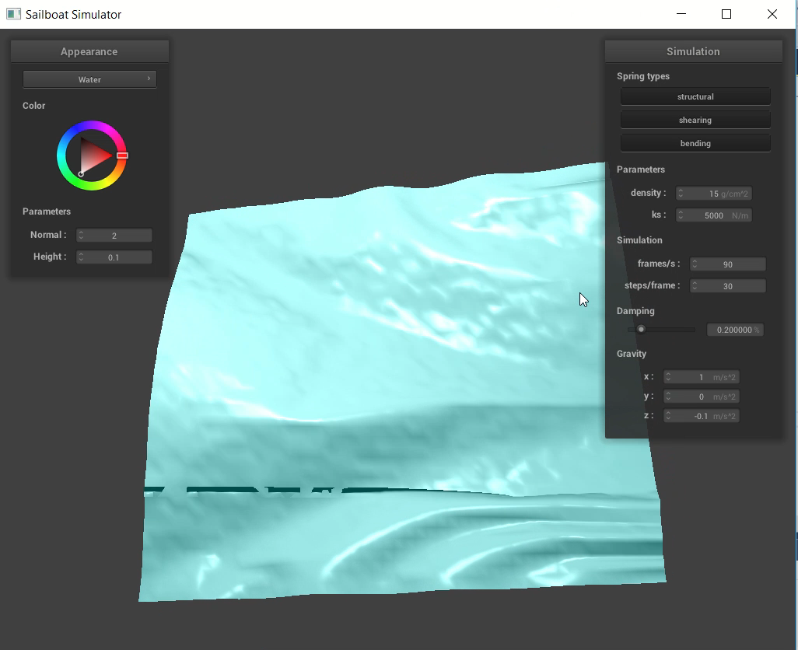
Environment Simulator
We built an environment simulator that has both wind and light components!
Khadijah Flowers, Heesoo Jang, Anais Miller | CS 184

Slide 2
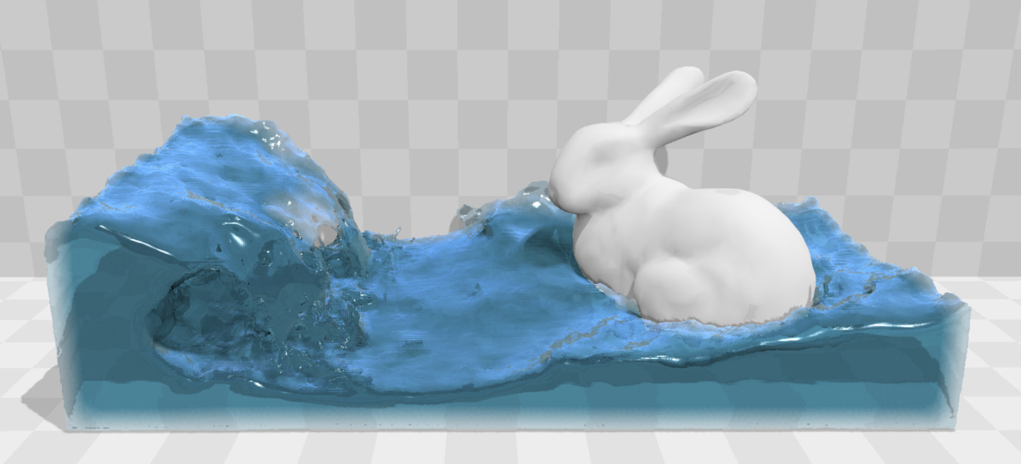
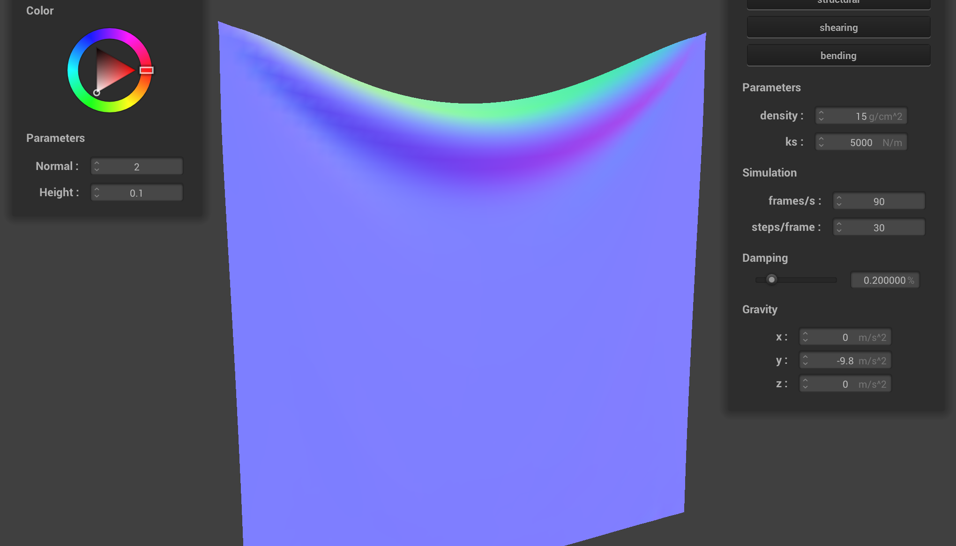
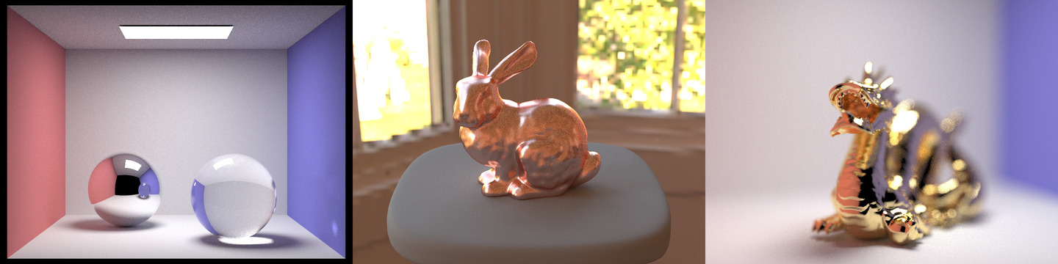
Why weather?
fluid
+
cloth
+
shaders
}
= weather
Notes:
We were each interested in different parts of this class. The boat simulator was our combination of these three different parts into one complex project.

Slide 3
Why does it matter?
Games
Virtual Reality
Movie Scenes
Making scenes appear realistic
Notes:
How will our project be used?

Slide 4
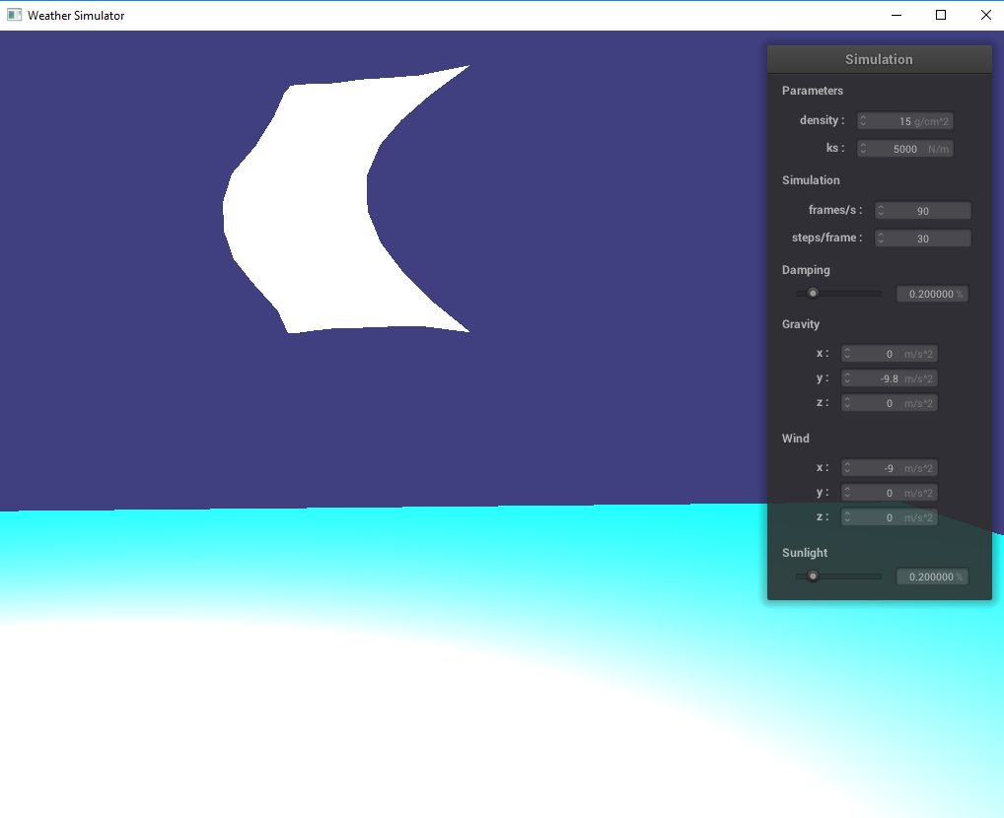
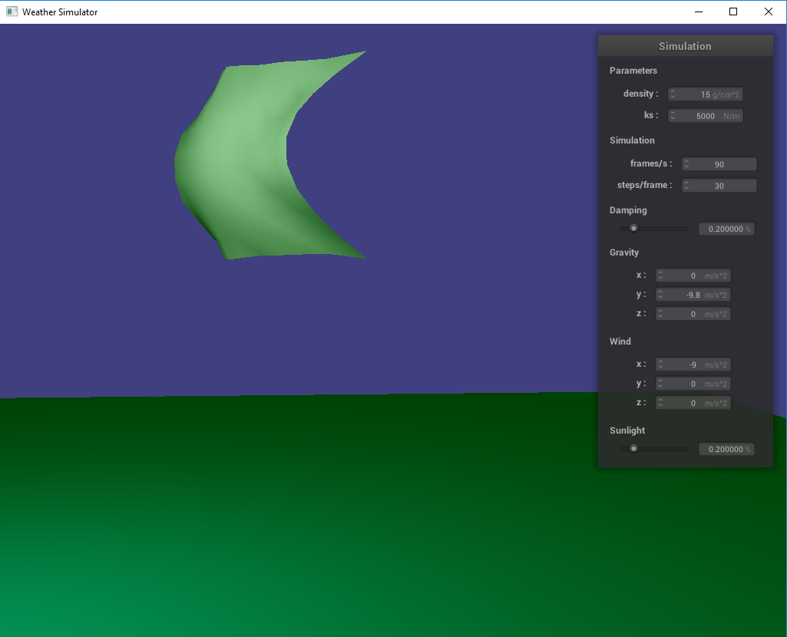
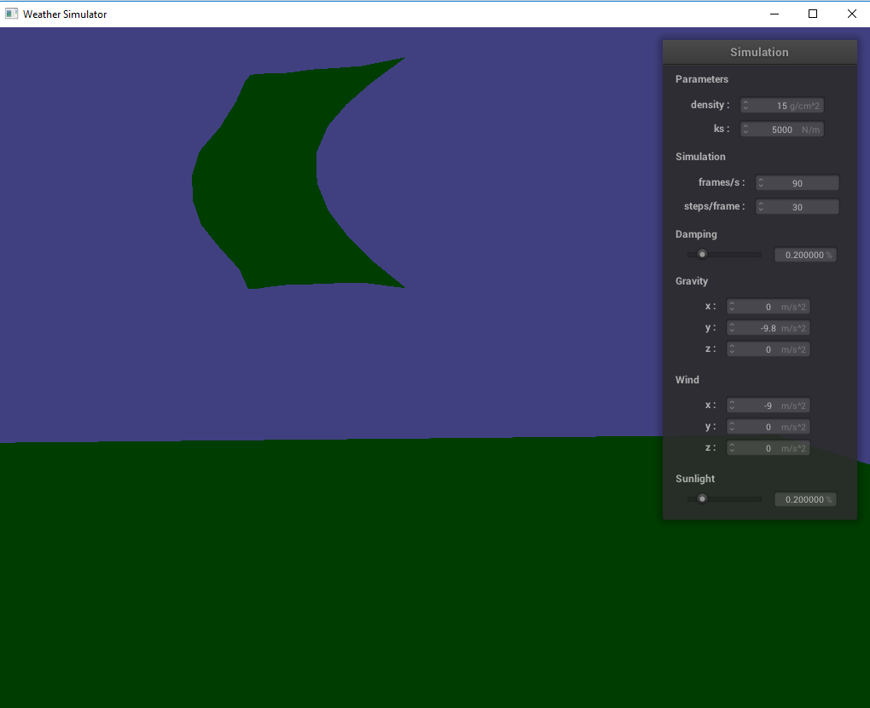
Demo Time
Notes:
Explain what is cool / hard about it, what's unique to your project, what we should pay attention to, what you are proud of

Slide 5
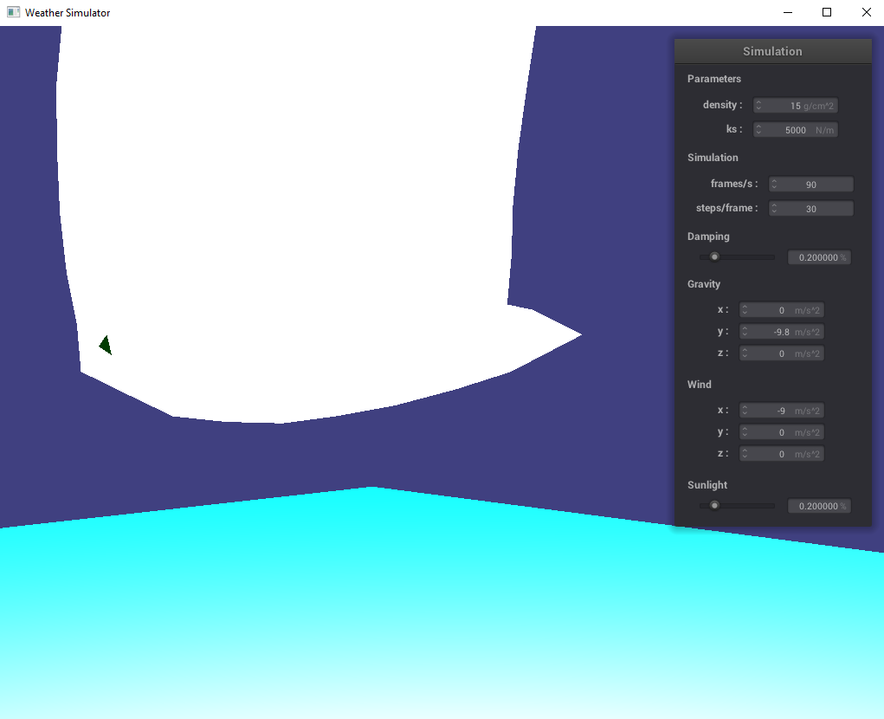
Technical Approach & Implementation
Wind
2. Direction and Movement
3. Light

Slide 6
What We Learned
This was hard lol
… and fun!!
GUIs
Shaders
Cloth Movement
OpenGL
.dae

Slide 7
Questions and Comments?

